Slide 1
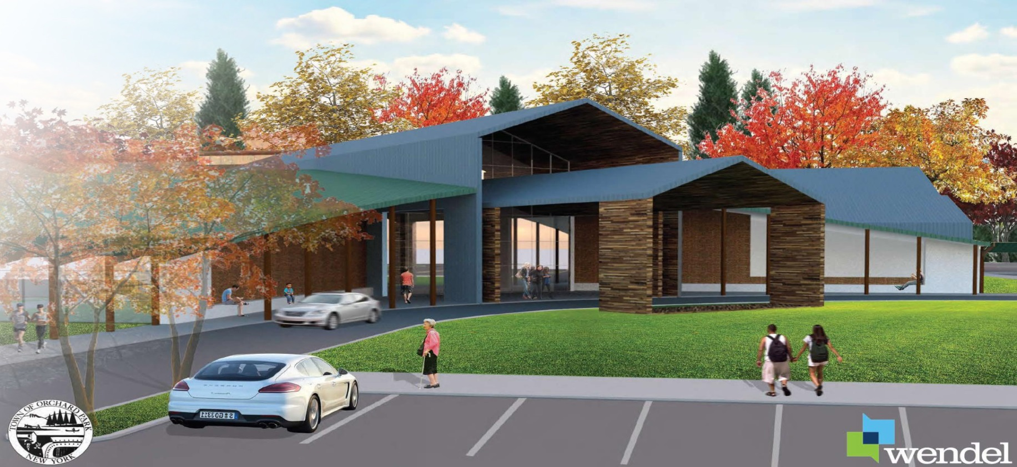
COMMUNITY ACTIVITY CENTER REFERENDUM
November 08, 2016

Slide 2
CONTEXT. The over 65 and under 18
populations have been on the rise in recent years, causing overcrowding at the senior center and within the existing recreation programs.

Slide 3
In 2009 the Town and their consultants produced a report titled “Master Plan for Improvements at Brush Mountain Park”. This plan established Park improvement goals, and identified a need and location for a proposed community/senior
center.

Slide 4
Due to cost constraints, the Community/ Senior Center was put on hold and the Town chose to pursue park improvements over a period of time.

Slide 5
In 2011 the Town Engineering Department revisited the center and the previous report. They created an interim program and building layout, however it was not pursued by the Town.

Slide 6
2015
Senior Services Task Force
Recreation Commission
Community Activity Center Task Force
2016
April – Architectural Report & Proposal
July – scientific poll of community
September – referendum

Slide 7
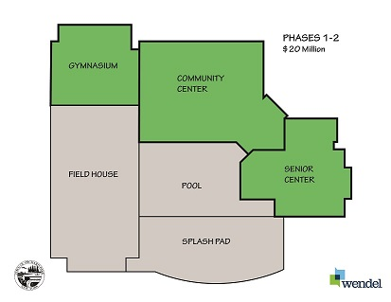

Slide 8
Core area which is centrally located and inclusive of an entry/reception area, shared office space for various departments and programs, a conference room, staff lounge, office storage, locker rooms and a family changing room.

Slide 9
Community center for communal activities for children, young adults and families. Included will be a multi-purpose flexible activity room (e.g., aerobics, dance, yoga, etc.), a flexible fitness or portable class room area, a flexible game and activities room (e.g., pool, ping pong, Wii, card tables, etc.), and a flexible and secure child watch space for toddlers.

Slide 10
Senior center inclusive of multi-purpose classrooms, a large, divisible and flexible multi-purpose room for such things as dining and various activities (also usable for community events such as weddings, movies, etc.), an arts and crafts room, library, wellness and medical screening rooms, a teaching kitchen and a billiards room.

Slide 11
Gym with a multi-activity floor striped for multiple sports (basketball, volleyball, pickle ball, etc.) with roll-up vertical nets to subdivide the gym for concurrent use by multiple users.

Slide 12
ANNUALIZED OPERATIONS & MANAGEMENT
Additional Costs | Additional Revenues | Capital & Maintenance Savings | Net
($148,600) | $100,000 | $75,000 | $26,400
Note: Solar could net future annual savings of $100,000 to town.

Slide 13
FUNDING
Capital campaign goal of $1,500,000 to $2,000,000.
Sale of the Town’s current Senior Center would produce between $500,000-$600,000.

Slide 14
BONDING
Anticipated $14,000,000 project build.
Current interest rate = 2.115%.
✓ Median valued home = $220,500 full /
$121, 275 assessed

Slide 15
Annual – Full Valuation | $220,500 @ 2.115% | $220,500 @ 2.75% | $220,500 @ 3.75%
$12,000,000 | $42.19 | $45.93 | $52.17
$14,000,000 | $49.22 | $53.59 | $60.86
$16,000,000 | $56.25 | $61.24 | $69.56

Slide 16
Month – Full Valuation | $220,500 @ 2.115% | $220,500 @ 2.75% | $220,500 @ 3.75%
$12,000,000 | $3.52 | $3.83 | $4.35
$14,000,000 | $4.10 | $4.47 | $5.07
$16,000,000 | $4.69 | $5.10 | $5.80

Slide 17
Annual – Assessed Valuation | Per $1000 @ 2.115% | Per $1000 @ 2.75% | Per $1000 @ 3.75%
$12,000,000 | X .00035 | X .00038 | X .00043
$14,000,000 | X .00041 | X .00044 | X .00050
$16,000,000 | X .00046 | X .00050 | X .00057

